Slide 1
Lead Scoring Case Study (Logistic Regression)
BY: Vikrant Kakroo

Slide 2
Contents
◆ Problem statement
◆ Problem approach
◆ EDA
◆ Correlations
Model Evaluation
◆ Observations
◆ Conclusion

Slide 3
Problem Statement
◆ An education company named X Education sells online courses to industry professionals.
On any given day, many professionals who are interested in the courses land on their website and
browse for courses. They have process of form filling on their website after which the company
that individual as a lead.
◆ Once these leads are acquired, employees from the sales team start making calls, writing emails,
etc. Through this process, some of the leads get converted while most do not.
◆ The typical lead conversion rate at X education is around 30%. Now, this means if, say, they
acquire 100 leads in a day, only about 30 of them are converted. To make this process more
efficient, the company wishes to identify the most potential leads, also known as Hot Leads.
◆ If they successfully identify this set of leads, the lead conversion rate should go up as the sales
team will now be focusing more on communicating with the potential leads rather than making
calls to everyone

Slide 4
Business Objective
Lead X wants us to build a model to give every lead a lead score between 0 -100 .
So that they can identify the Hot leads and increase their conversion rate as well.
The CEO want to achieve a lead conversion rate of 80%.
They want the model to be able to handle future constraints as well like Peak time
actions required, how to utilize full man power and after achieving target what
should be the approaches.

Slide 5
Problem Approach
Importing the data and inspecting the data frame
Data preparation
EDA
Dummy variable creation Test-Train split
Feature scaling
Correlations
Model Building (RFE Rsquared VIF and pvalues)
Model Evaluation
Making predictions on test set

Slide 6
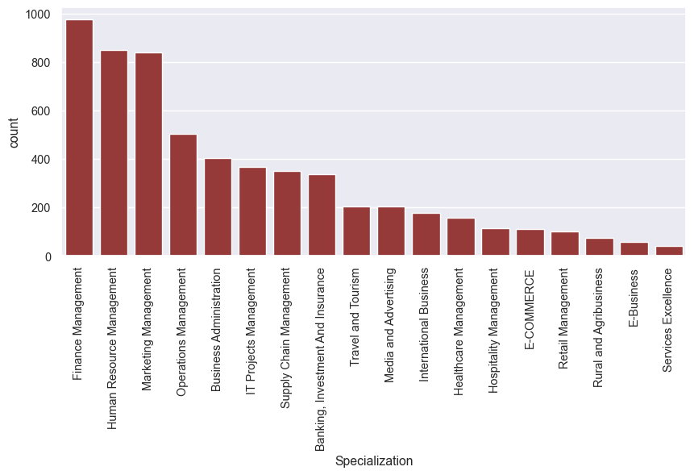
EDA –Data Cleaning
◆ There are a few columns in which there is a level called 'Select' which is taking care.
Leads from HR, Finance & Marketing management specializations are high probability to convert.

Slide 7
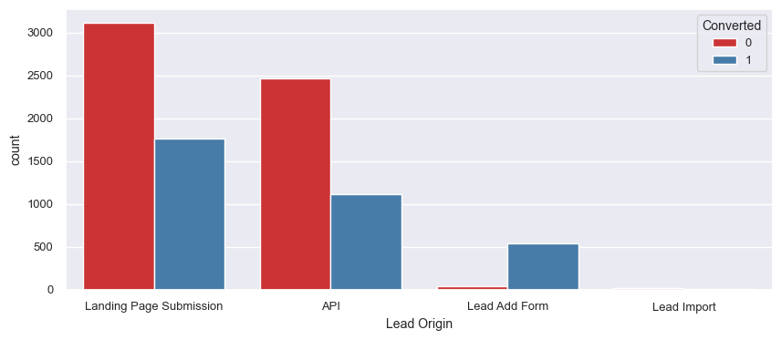
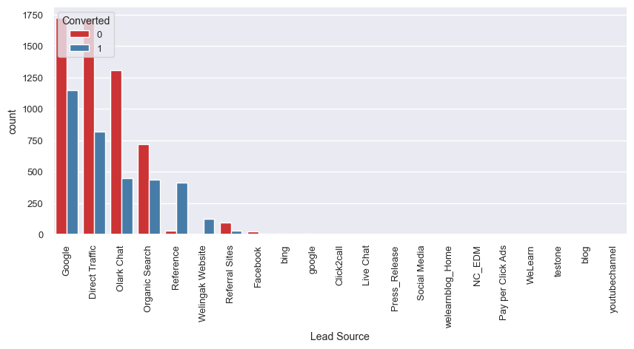
Lead Source & Lead origin
In lead source the leads through google & direct traffic high probability to convert

Slide 8
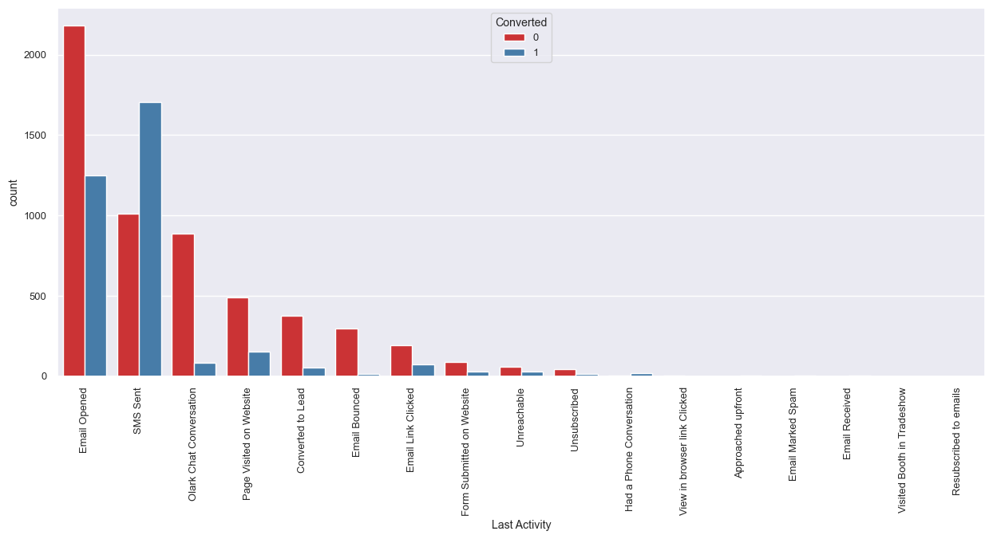
Last lead Activity
Leads which are opening email have high probability to convert, Same as Sending SMS will also benefit.

Slide 9
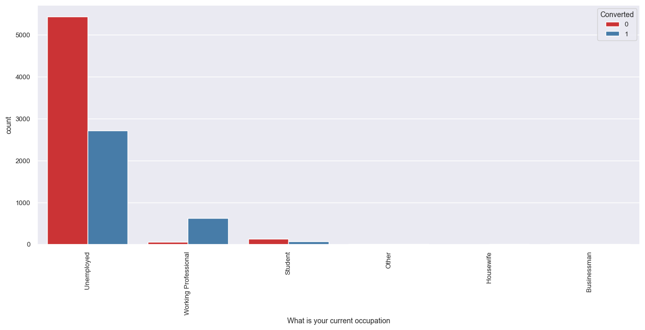
Last What is Your Occupation
Leads which are Unemployed are more interested to join the course than others.

Slide 10
OUTCOME
NOTE: There is no correlation between the variables
1) Comparing the values obtained for Train & Test:
Train Data:
Accuracy : 81.0 %
Sensitivity : 81.7 %
Specificity : 80.6 %
Test Data:
Accuracy : 80.4 %
Sensitivity : 80.4 %
Specificity : 80.5 %
Thus we have achieved our goal of getting a ballpark of the target lead conversion rate to be around 80% . The Model seems to predict the Conversion Rate very well and we should be able to give the CEO confidence in making good calls based on this model to get a higher lead conversion rate of 80%.
2) Finding out the leads which should be contacted: The customers which should be contacted are the customers whose "Lead Score" is equal to or greater than 85. They can be termed as 'Hot Leads'.

Slide 11
Recommendations
Recommendations:
The company should make calls to the leads coming from the lead sources "Welingak Websites" and "Reference" as these are more likely to get converted.
The company should make calls to the leads who are the "working professionals" as they are more likely to get converted.
The company should make calls to the leads who spent "more time on the websites" as these are more likely to get converted.
The company should make calls to the leads coming from the lead sources "Olark Chat" as these are more likely to get converted.
The company should make calls to the leads whose last activity was SMS Sent as they are more likely to get converted.
The company should not make calls to the leads whose last activity was "Olark Chat Conversation" as they are not likely to get converted.
The company should not make calls to the leads whose lead origin is "Landing Page Submission" as they are not likely to get converted.
The company should not make calls to the leads whose Specialization was "Others" as they are not likely to get converted.
The company should not make calls to the leads who chose the option of "Do not Email" as "yes" as they are not likely to get converted.

Slide 12
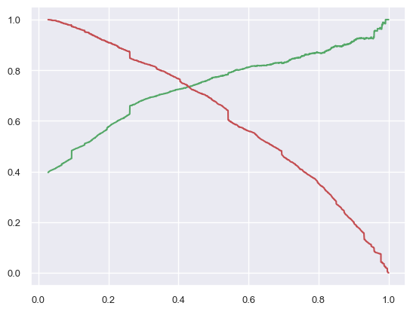
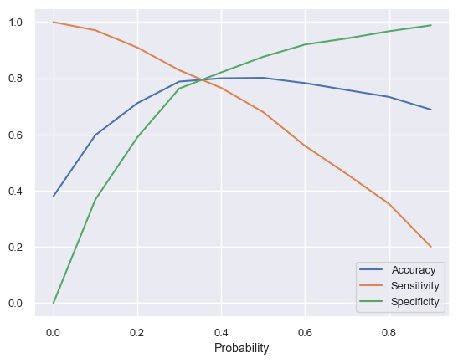
Model Evaluation ROC curve
0.42 is the tradeoff between Precision and Recall - Thus we can safely choose to consider any Prospect Lead with Conversion Probability higher than 42 % to be a hot Lead

